Slide 1
Emerging Employer Views of People with Disabilities and the
Future of Job Development:
Some Food for Thought
APSE 2008
David Hoff
Institute for Community Inclusion, UMass Boston
617-287-4308; david.hoff@umb.edu
www.communityinclusion.org
www.massworks.org
www.seln.org

Slide 2
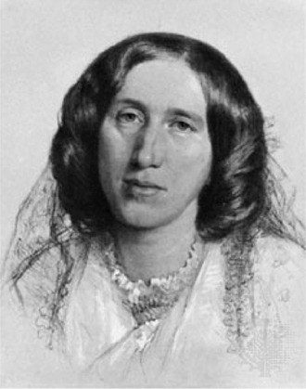
“BLESSED IS THE MAN WHO,
HAVING NOTHING TO SAY,
ABSTAINS FROM
GIVING US WORDY EVIDENCE OF THE FACT.”
George Eliot

Slide 3
“Demand-side job development means finding a way for employers to save money, make money, or otherwise improve their operation as a result of their placement.”
FOOD FOR THOUGHT
# 1
Is it always about money?
What other ways can hiring a person with a
disability “improve” the operation?
What about indirect benefits?
Are they still important?
Do they apply to demand-side job development?

Slide 4
BENEFITS OF HIRING PEOPLE WITH DISABILITIES
(Butterworth & Pitt-Catsouphes - ICI & BU Center on Work & Family - 1995)
Benefits directly related to business objectives
  e.g.: need for qualified employees
Benefits indirectly related to business objectives
  e.g.: community relations, public relations
Benefits related to organizational values
  e.g.: moral obligation, doing the right thing

Slide 5
FOOD FOR THOUGHT # 2
Does job development always need
to start with the job seeker?
Is starting with the business and
working backwards okay?

Slide 6
“Without the ability to temporarily forget what we know, our minds remain cluttered with ready-made answers & we never have an opportunity to ask questions that lead off the path in new directions.”
Roger Von Oech

Slide 7
Why It’s Sometimes Okay to Start with the Employer
Need for knowledge of local economy & businesses to match job seeker interests/needs
Discovering new and different opportunities
which had not previously been considered
Corporate/large employer job development -
it can take a lot of time
Sometimes a job is just a job
Job seekers interests, choices and needs still should ultimately drive the placement process.

Slide 8
FOOD FOR THOUGHT # 3
We need to understand that deviating from the norm has consequences, so we should be cautious in doing so.

Slide 9
NATURAL SUPPORTS RESEARCH
MANK, CIOFFI, YOVANOFF - Oregon Natural Supports Project, 1996
If employee with a disability is treated similarly to employees without disabilities, concerning these elements of the employment process, the employee with a disability is more likely to be well integrated into the workplace:
JOB ACQUISITION PROCESS
COMPENSATION
WORK ROLES
INITIAL ORIENTATION & TRAINING
Better Integration =
Higher Hourly & Monthly Earnings

Slide 10
FOOD FOR THOUGHT
# 4
This all sounds good,
but do we have the workforce and capacity
to make it happen beyond demonstration projects?

Slide 11
Quality Job Development:
How Do We Make It Happen on A Larger Scale?
What are the qualities of a good job developer?
How do we ensure that more individuals in our field have the right technical and non-technical skill set?
Do we need to fundamentally re-think the job developer role?
  Stronger technical knowledge?
  More immersed in industry sectors?

Slide 12


“You can teach a turkey to climb a tree, but it’s easier to hire a squirrel.”
From: Lyle Spencer, David McCleelan, Signe Spencer - Competency Assessment Methods

Slide 13
FOOD FOR THOUGHT
# 5
Job Development:
Do we really know what works?

Slide 14

“You manage what you measure.”

Slide 15
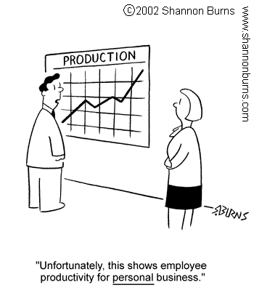
“What gets measured, gets done.”

Slide 16
Which of these questions can you answer?
Which employer contact methods are most effective?
On average, how many contacts does it take to generate a job?
On average, how long does it take to place an individual?
What is the percentage of staff time dedicated to job development?
Who are the largest employers in your local economy?
Are placements reflective of the local economy?
Are placements reflective of the individual choices and preferences of job seekers?
What is your placement retention rate over time?
What staff are your most effective job developers and why?

Slide 17
RELATIONSHIP BETWEEN SOURCE OF JOB LEADS AND JOB OFFERS
(From “Job Development Strategies For Placing Persons With Psychiatric Disabilities Into Supported Employment Jobs” By R. Gervey and H. Kowal, 1995)
90% of job leads came from newspapers help wanted ads
8% of job leads came from employers who had prior contact with program
1% of job leads came from walk-ins
1% of job leads came from directory listings (i.e. yellow pages, chamber directories)

Slide 18
RELATIONSHIP BETWEEN SOURCE OF JOB LEADS AND JOB OFFERS (Continued)
70% of the job offers were from employers that had previous contact with the program
22% of the job offers came from responding to help wanted newspaper
8% of the job offers came from walking in to a company or from a help wanted sign in the window
NO job offers were obtained using directory listings

Slide 19
RELATIONSHIP BETWEEN SOURCE OF JOB LEADS AND JOB OFFERS (continued)
It took on average:
42 contacts per job offer
6 contacts per job interview
7 interviews per job offer

Slide 20
“The nature of passive resistance within a nonprofit setting is at levels that could teach Gandhi lessons.”
- Reynold Levy
President of Lincoln Center for the Performing Arts, and former president of International Rescue Committee

Slide 21
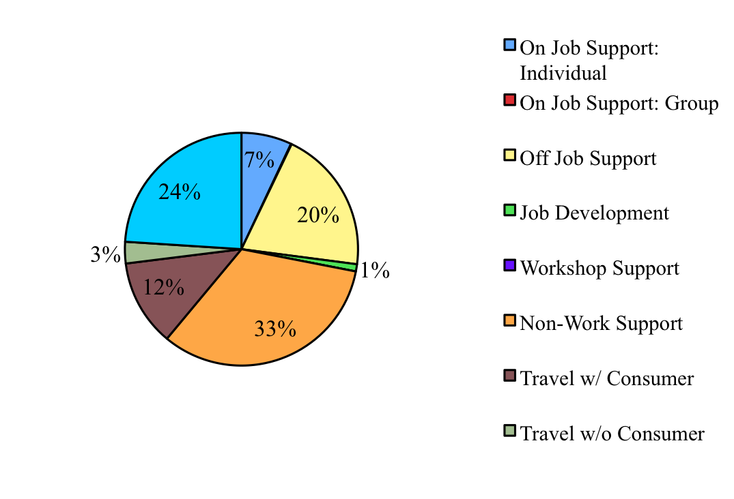
Data Example
Staff Time - XYZ Agency

Slide 22
Data Example -
Job Development Data
 | Jan - March | April - June | July - August | Sept. - Dec.
# of Placements | 8 | 5 | 7 | 3
Avge. Hrs. Job Dev./ Placement | 43 | 39 | 45 | 49

Slide 23

Data Example -
Length of Placement by Percentage of Participants
 | Nov. 06 | May 07 | Nov. 07
Employed < 90 Days | 16% | 7% | 14%
Employed 90-180 Days | 13% | 26% | 22%
Employed > 180 Days | 71% | 67% | 64%
Total Employed | 100% | 100% | 100%

Slide 24
A Challenge to
Our Field
Gut instincts are not enough.
Individual providers need to better manage their job development processes through use of data and accountability
We as a field need to have a stronger basis of research regarding effective job development practices

Slide 25
GERRY PROVENCAL
“We’re Far Too Patient With The Passage Of Time For People With Disabilities. . . Time Is As Precious For A Person With A Disability As It Is For All Of Us.”

